Slide 2
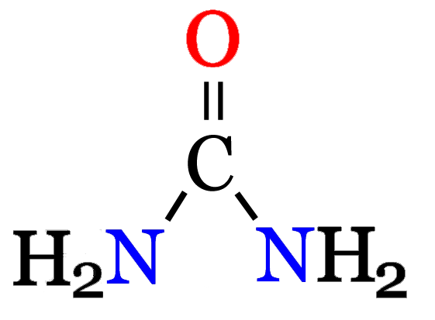
“A dead frog place in saturated
urea solution becomes translucent and falls to pieces in a few hours.”
- W. Ramsden (1902) Journal of Physiology

Slide 3
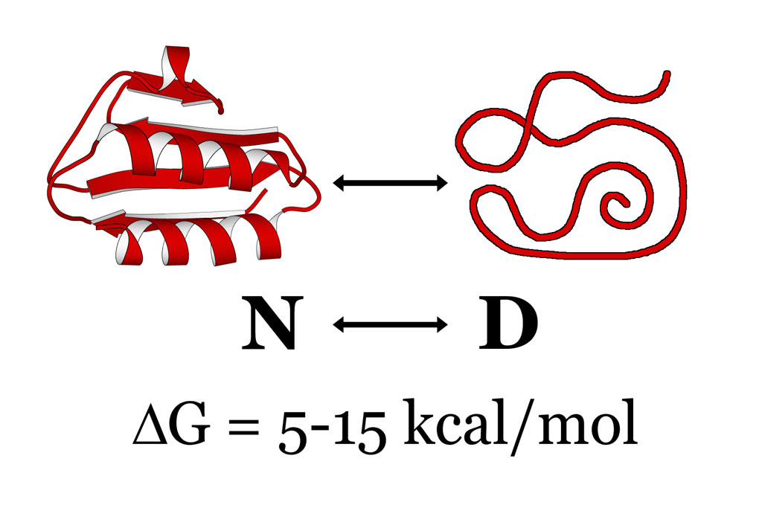

Slide 6
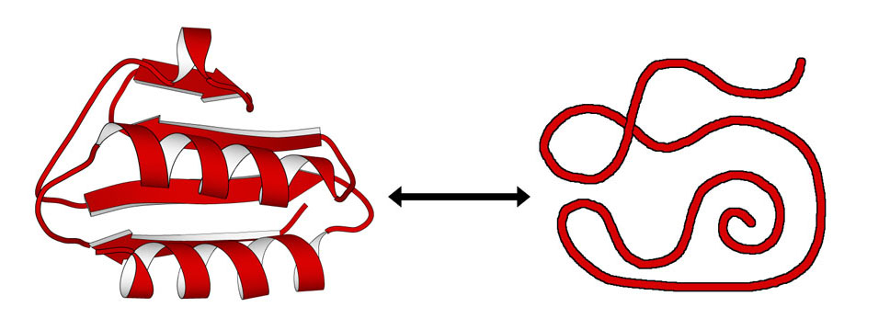

Slide 7
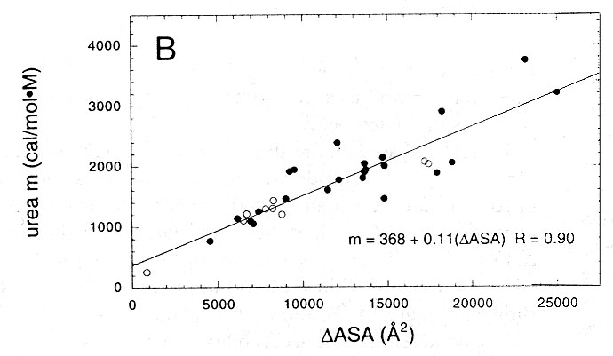
Myers, et al. (1995) Protein Science

Slide 8
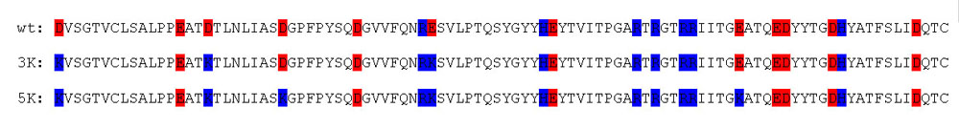
Protein | Net Charge @ pH 3 | Net Charge @ pH 7
wt | +7 | -5
3K | +10 | +1
5K | +12 | +5

Slide 9
Protein | ΔH_{m} (kcal/mol) | T_{m} (ºC) | ΔΔG measured (kcal/mol) | ΔΔG calculated (kcal/mol)
wt | 91 | 47.2 | -- | --
D1K | 89 | 48.7 | 0.4 | --
D17K | 90 | 43.3 | -1.1 | --
D25K | 93 | 50.2 | 0.9 | --
E41K | 92 | 42.9 | -1.2 | --
E74K | 94 | 51.1 | 1.1 | --
2K (E41K, D17K) | 83 | 39.5 | -2.2 | -2.3
3K (E41K, D17K, D1K) | 78 | 40.4 | -2.0 | -1.9
4K (E41K, D17K, D1K, D25K) | 84 | 44.4 | -1.4 | -1.0
5K (E41K, D17K, D1K, D25K, E74K) | 82 | 46.8 | -0.1 | 0.1

Slide 10
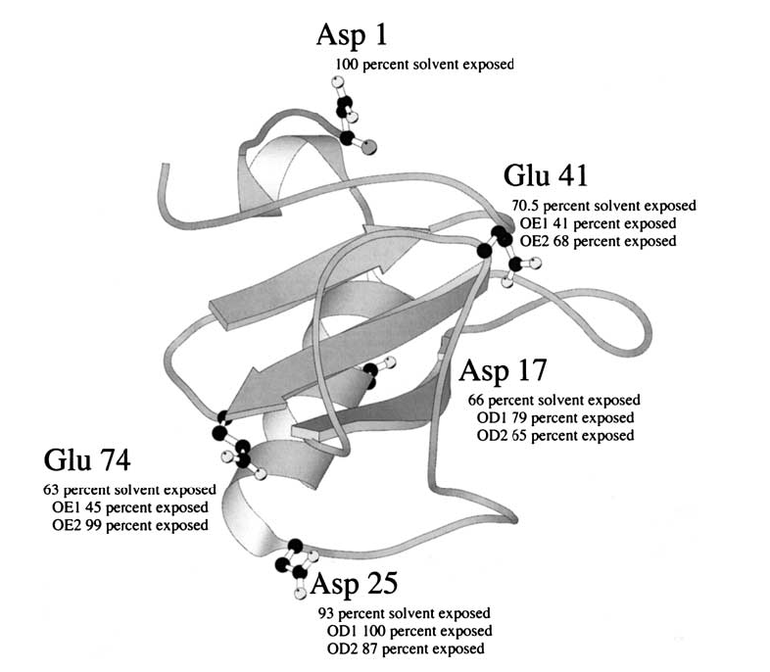

Slide 11
Protein | Net Charge @ pH 3 | Net Charge @ pH 7
wt | +7 | -5
3K | +10 | +1
5K | +12 | +5

Slide 12
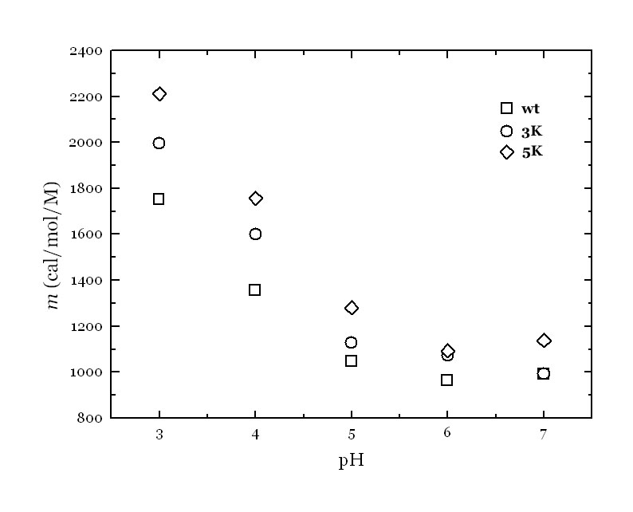
Pace & Shaw (2000) Proteins: Structure, Function and Genetics

Slide 14
    “Urea is in many respects an unusual reagent, and all of its mysteries have not as yet been explored.”
- Bull, Breese, Ferguson & Swenson
(1963) Archives of Biochemistry & Biophysics 104, 297‑304

Slide 15
Protein | k_{cat} (s⁻¹) | K_{M} (M) | k_{cat}/K_{M} (M⁻¹s⁻¹)
wt | 146 | 1.9 x 10⁻⁴ | 7.7 x 10⁵
3K | 88 | 1.4 x 10⁻⁴ | 6.3 x 10⁵
5K | 10.5 | 1.0 x 10⁻⁴ | 1.1 x 10⁵

Slide 16
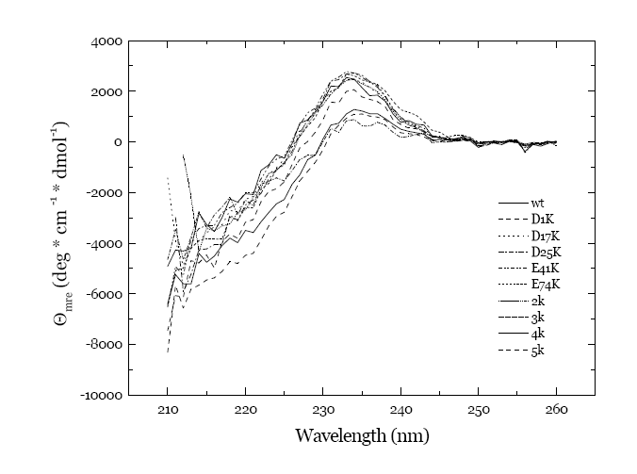

Slide 17
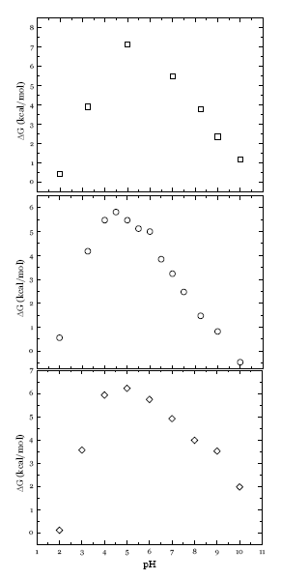


Slide 18
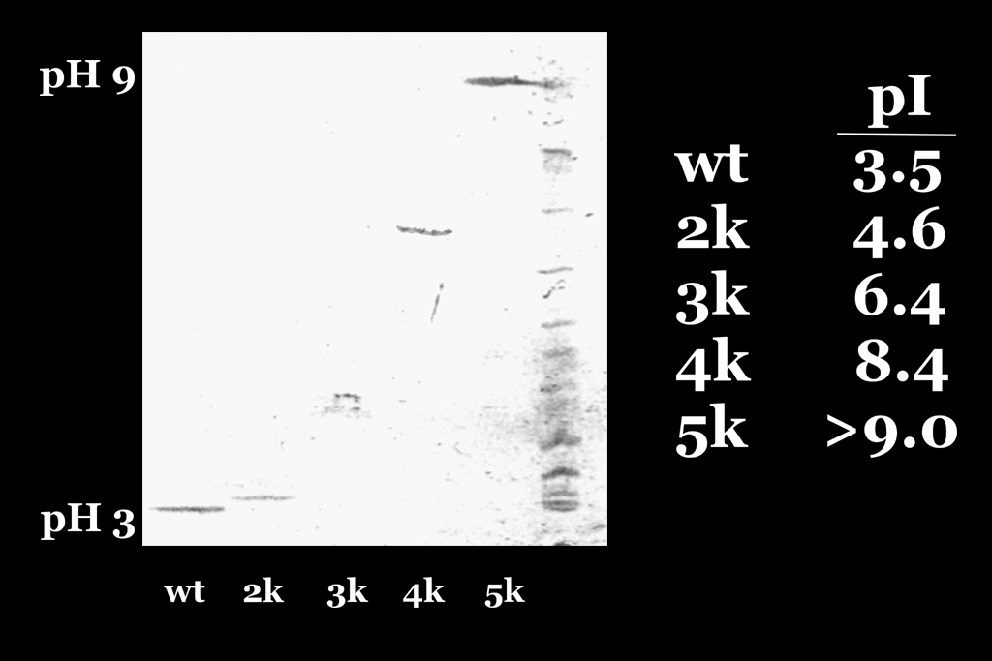

Slide 19
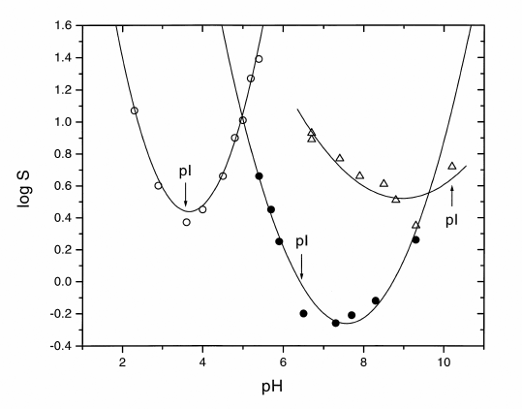

Slide 20
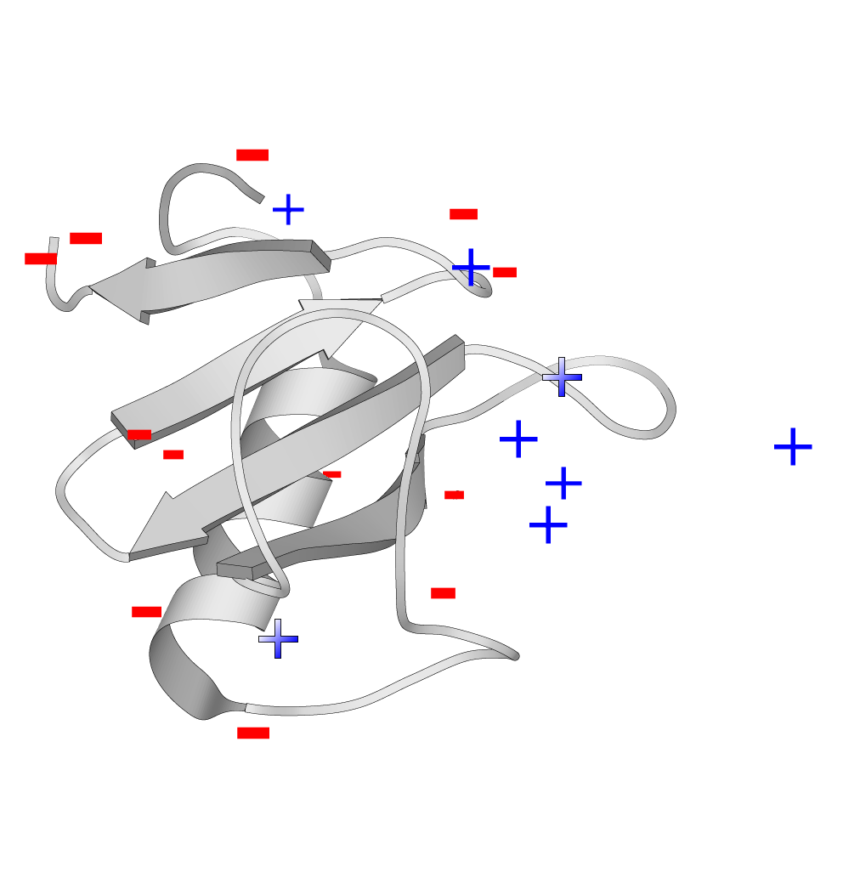

Slide 21
“What is the secret of life?” I asked.
“Protein,” the bartender declared.
-Kurt Vonnegut
Cat’s Cradle (1963)

