Slide 1
Reading the Biochemical Literature

Slide 2
The Literature is Vast
~150 journals publishing in molecular biology
Yearly page counts (2020, 2025)
  Biochemistry 4,840 pages
  JMB 6,230 pages
  JBC 18,650 pages
  PNAS 33,720 pages

Slide 3
What is Published?
Primary research articles
  Reports of novel research findings
Review articles
  Summarize recent and important findings on a particular topic
    Either targeted toward those in the field or toward those outside the field

Slide 4
What is Published (cont’d)?
Comments and commentaries
  Typically comments on a research article in that issue, written by a third party, highlighting the importance of the finding
    PNAS, Nature Journals
Correspondence and letters
  Short discussions on a topic
    Medical journals, Nature

Slide 5
What is Published (cont’d)?
Specialty formats
  News, book reviews, opinion, for the record, policy forum, editorials and others
Errata
  Corrections of errors, either scientific or typographical

Slide 6
Example TOCs
Current issue of Science
Current issue of Nature
Current issue of PNAS
Current issue of Biochemistry

Slide 7
Where to Publish?
Breadth of interest
  “…not of broad enough interest.”
Choosing among the focused journals
  Journal focus
  Society affiliations
  Impact factor
    Citation based

Slide 8
Impact Factor†
Calculated as:
Number of citations received in one year
Number of articles published in the two previous years
†Garfield E and Sher IH. 1963. New Factors in the Evaluation of Scientific Literature
Through Citation Indexing. Am Doc. 14:195-201

Slide 9
Selected Impact Factors (1994)
Cell 39.191
Nature 25.466
Science 22.067
Microbiological 20.754
Reviews
PNAS 10.667
JBC 7.716
JMB 6.018
Biochemistry 5.234
Weed Science 0.670
Texas Journal of Science 0.080
Canadian Field-Naturalist 0.063
Great Lakes Entomologist 0.046
Enzyme and Protein 0.027
Eurasian Soil Science 0.004

Slide 10


Other (modern) Measures
Eigenfactor† – IF alternate considering citation quality, excluding self-citation
  Method: random walk through the literature network, cp. page rank algorithm.
h index‡ – individual measure
  $h≡\# papers with citation \# ≥h$
† Bergstrom C. 2007. Eigenfactor: Measuring the value and prestige of scholarly journals. C&RL News. 68: 314-6
See www.eigenfactor.org/methods.php for full algorithm details.
‡ Hirsch JE. 2005. An index to quantify and individual’s scientific research output. PNAS. 102: 16569-72

Slide 11
Impactful Articles †
Lowry OH, Rosebrough NJ, Farr AL, Randall RJ. 1951. Protein measurement with the folin phenol reagent. J Biol Chem. 193:265-75. (366,829)
Laemmli UK. 1970. Cleavage of structural proteins during the assembly of the head of bacteriophage T4. Nature. 227:680-5. (266,148)
Bradford MM. 1976. A rapid and sensitive method for the quantitation of microgram quantities of protein utilizing the principle of protein-dye binding. Anal Biochem. 72:248-54. (247,479)
Sanger F, Nicklen S, Coulson AR. 1977. DNA sequencing with chain-terminating inhibitors. Proc. Natl. Acad. Sci. 74:5463-7. (70,392)
Chomczynski P, Sacchi N. 1987. Single-step method of RNA isolation by acid guanidinium thiocyanate-phenol-chloroform extraction. Anal Biochem. 162:156-9. (67,548)
†Van Noorden R, Maher B & Nuzzo R. 2014. The top 100 papers. Nature. 514:550-3. *(January 2026 numbers)

Slide 12
Why Read the Biochemical Literature?
For your own enjoyment
For your knowledge and understanding
For funding
So that you can reference intelligently

Slide 13
Dealing with the Volume
What scope do I need to read?
  Experimental results, techniques, clinical application
Where will I find this information?
  Which journals should I read?
Scanning selected journals
  Electronic tables of contents
  Split journal duties

Slide 14
Dealing with the Volume (cont.)
Library day
  Follow publication schedules
    Monthly, biweekly
  Copy new articles and classics
  Supplanted by electronic publishing
    Rolling publishing schedule
    TOCs via email
    TOCs via RSS

Slide 15
Journal Clubs
Reading by ‘force and coercion’
Weekly group discussions of current literature
Narrow or broad focus
Seminar practice
Cp. data club

Slide 16
Reading a Research Article
You can learn a lot from a title
You can learn more from an abstract
You can learn a lot more from the cartoon…

Slide 17
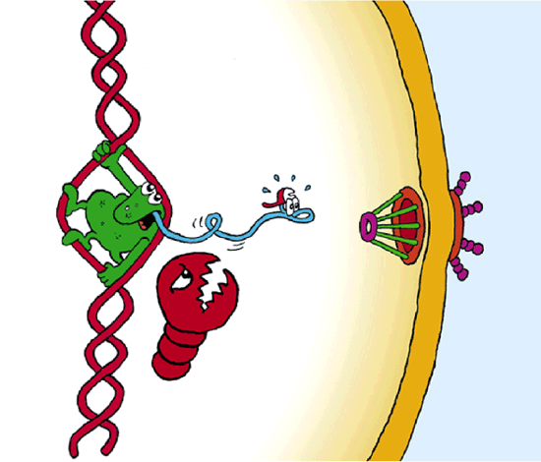
The Cartoon
Figure 1: Cartoon showing quality control of nascent eukaryotic mRNA.
Jensen TH, Rosbash M. 2003. Co-transcriptional monitoring of mRNP formation. Nat Struct Mol Biol 10:10-2.

Slide 18
Reading a Research Article (cont.)
What do you know about the authors?
  Reputation, affiliation, bias or philosophy
When was the article published?
  Current results or might they be outdated?
Where was the article published?
  What is the credibility of the journal?

Slide 19
Reading a Research Article (cont.)
Who do they reference?
  Classic papers, current research, colleagues?
Is this paper worth reading?
  That is, “Is it worth my time to read this paper?”

Slide 20
Reading in Detail
Most data presented in figures and tables
  Most information density – figures, tables and legends
  Data, with methods, first, draw conclusions second, then read what the authors have to say about the data
Methodology
  Do the data represent what the authors say they do?

Slide 21
Reading in Detail (cont.)
Do the authors rely on any assumptions or presuppositions?
Were the experiments adequately controlled?
Are the results statistically significant?
Do the data support the conclusions drawn by the authors?
  Causation and correlation

Slide 23
“Simple two-way correlations are never wholly adequate for showing cause and effect. At best they show a relation, but not necessarily a causal relationship.”
Alfred C. Kinsey. 1948. Sexual Behavior in the Human Male.
W. B. Saunders, Philadelphia.

Slide 24
Review Articles
Give an introduction and overview to the discipline, problem or technique
Summarize current findings and opinion
Direct the reader into the literature
  Review quality often based on breadth of literature surveyed, number of references
  Reviews indexed with number of references

Slide 25
“My first two years at U of C [University of Chicago] were superficially not very successful, with my grades (largely B’s) continuing to expose to all my non-genius qualities. But they prepared me for the future by instilling upon me three new values. The first was to focus on original sources instead of textbooks – read the great books themselves, not the interpretations of others. The second value was the importance of theory. Of course, you have to know some facts, but much more important is how to put them together in some rational scheme. And thirdly, you had to concentrate on learning how to think as opposed to improving memorization skills.”
- James D. Watson

