Slide 2
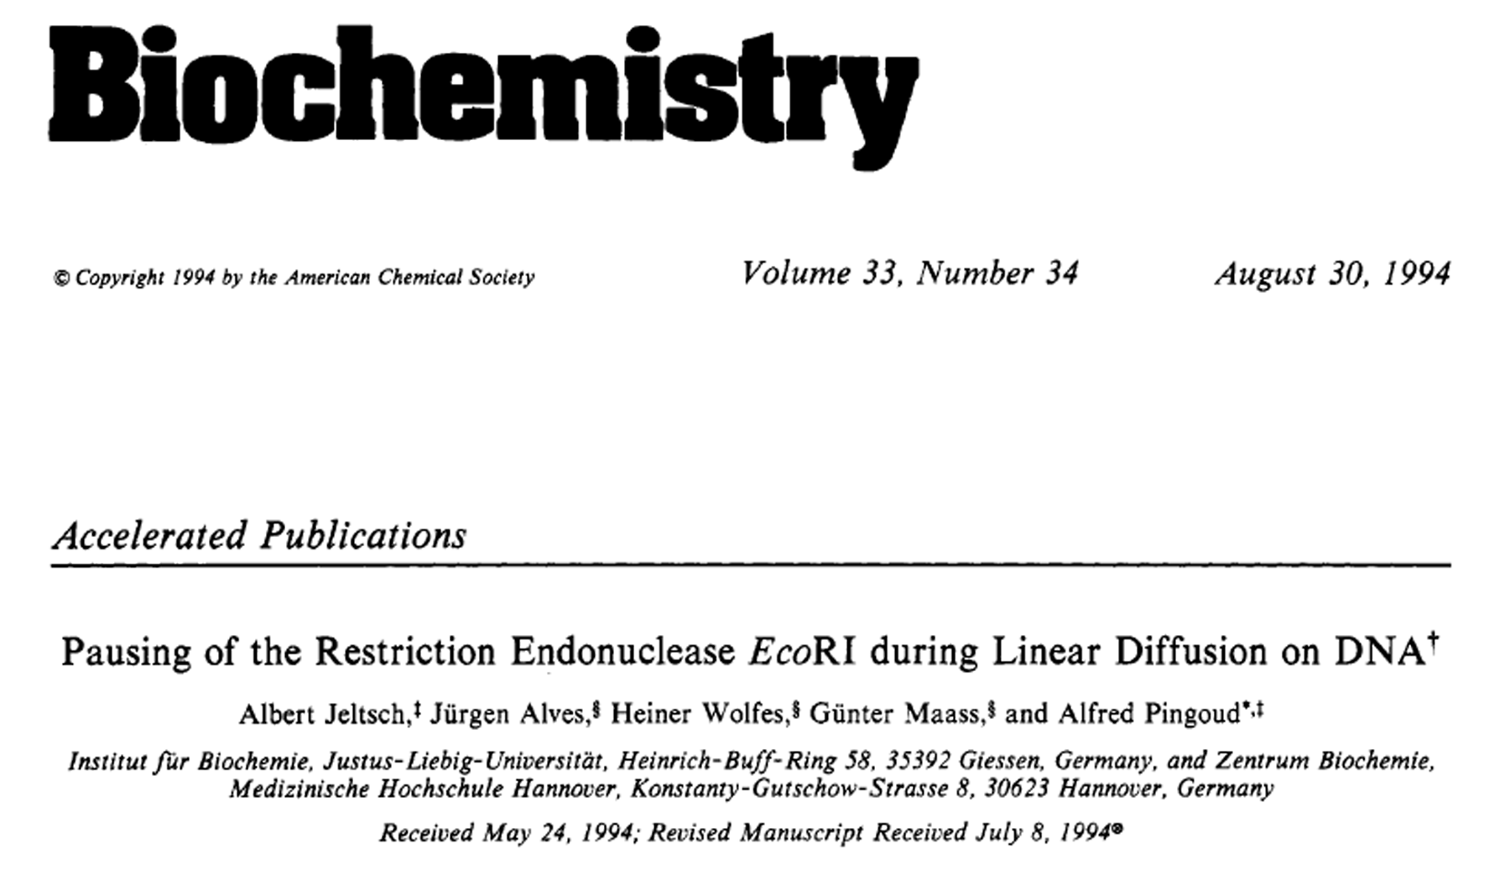

Slide 3
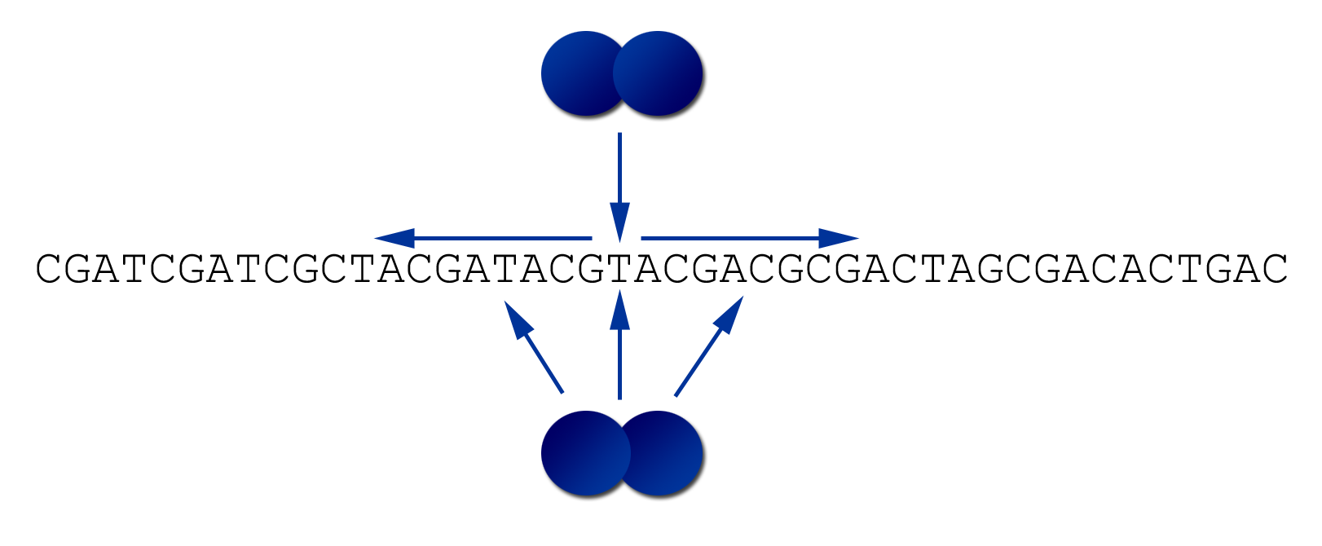

Slide 4
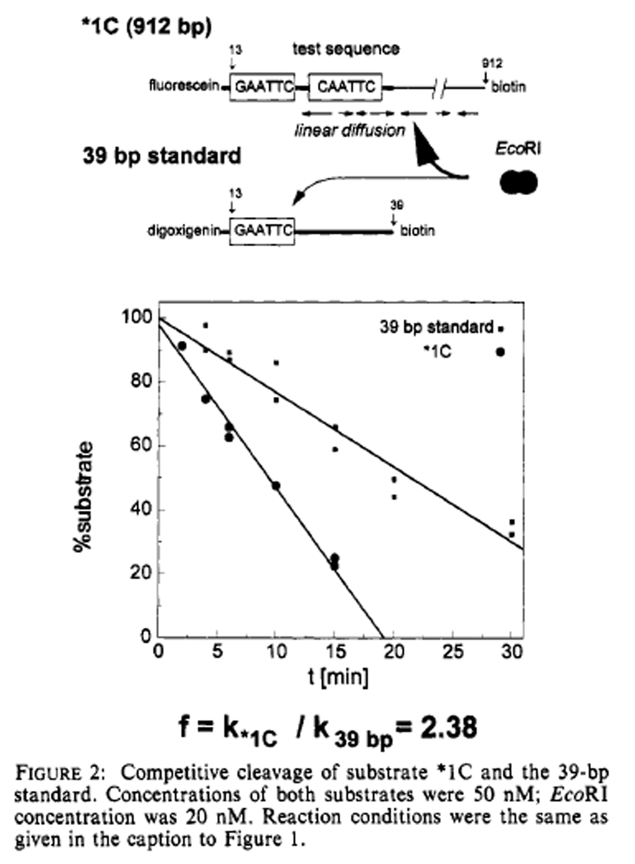

Slide 5


Slide 6
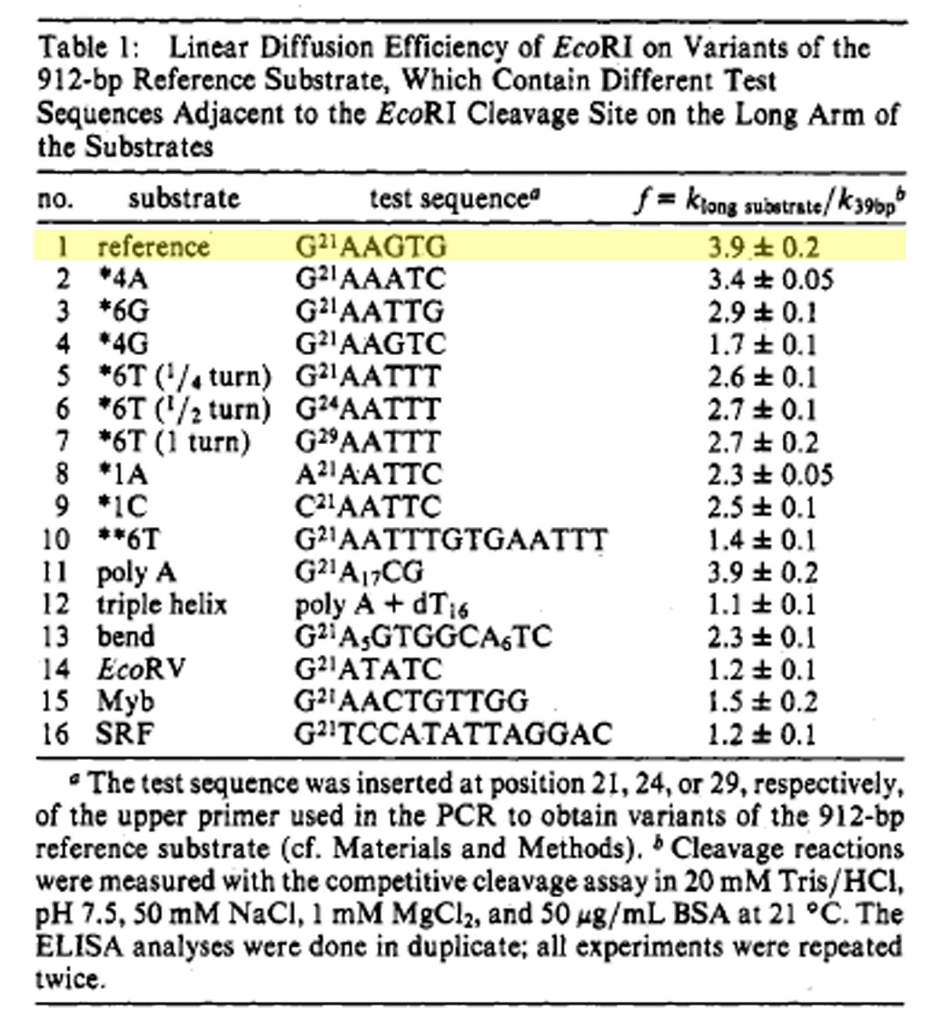

Slide 7
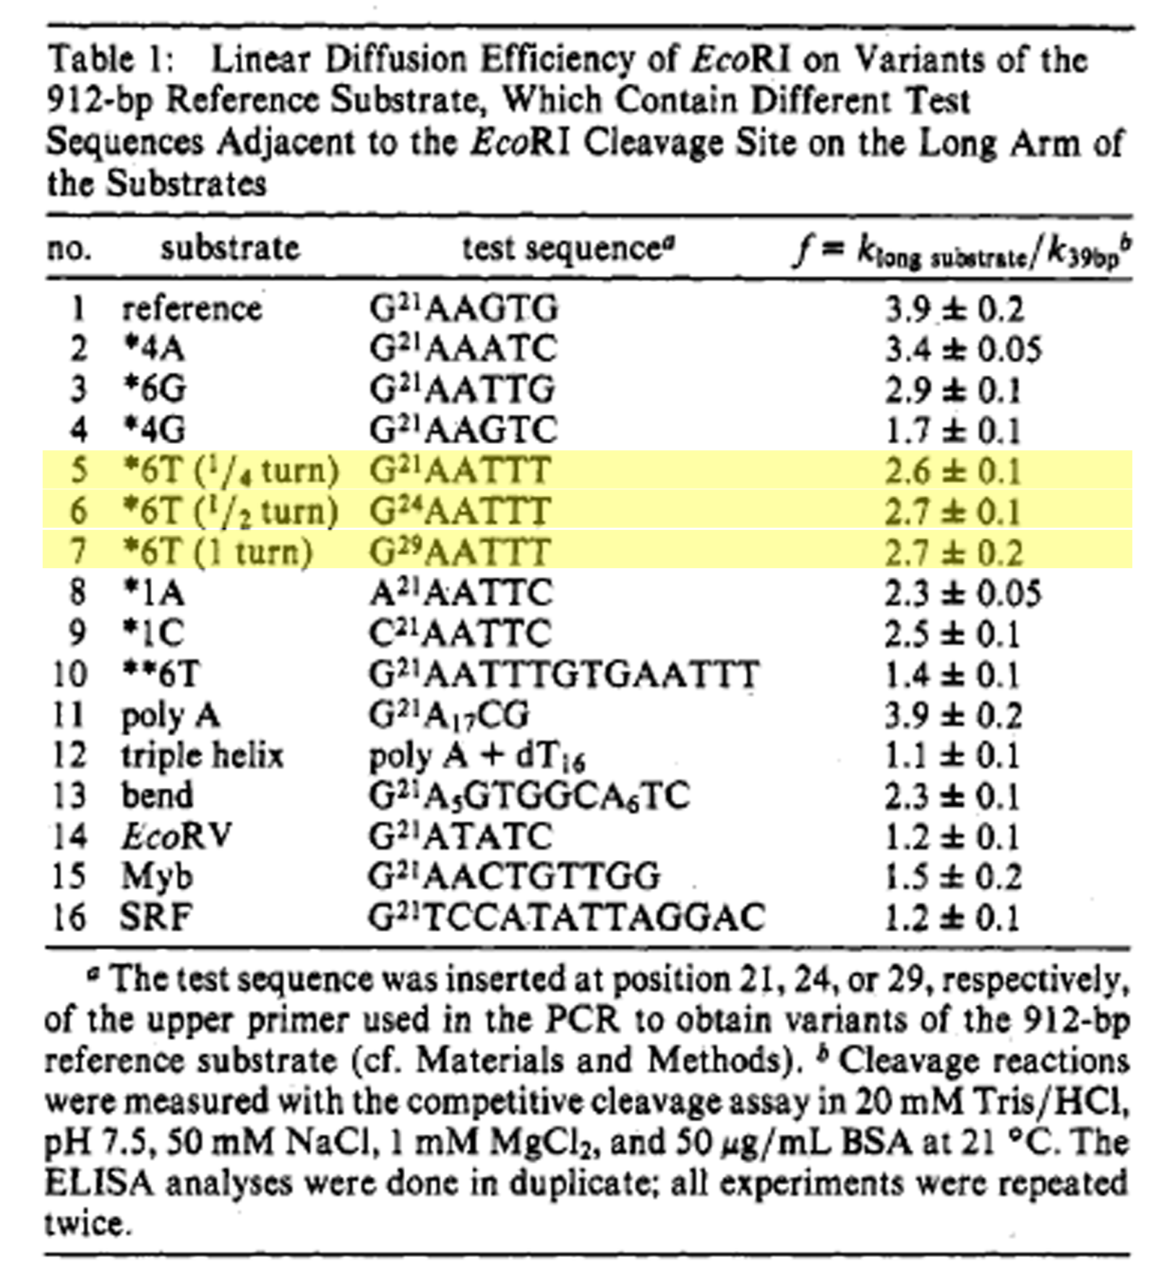

Slide 8
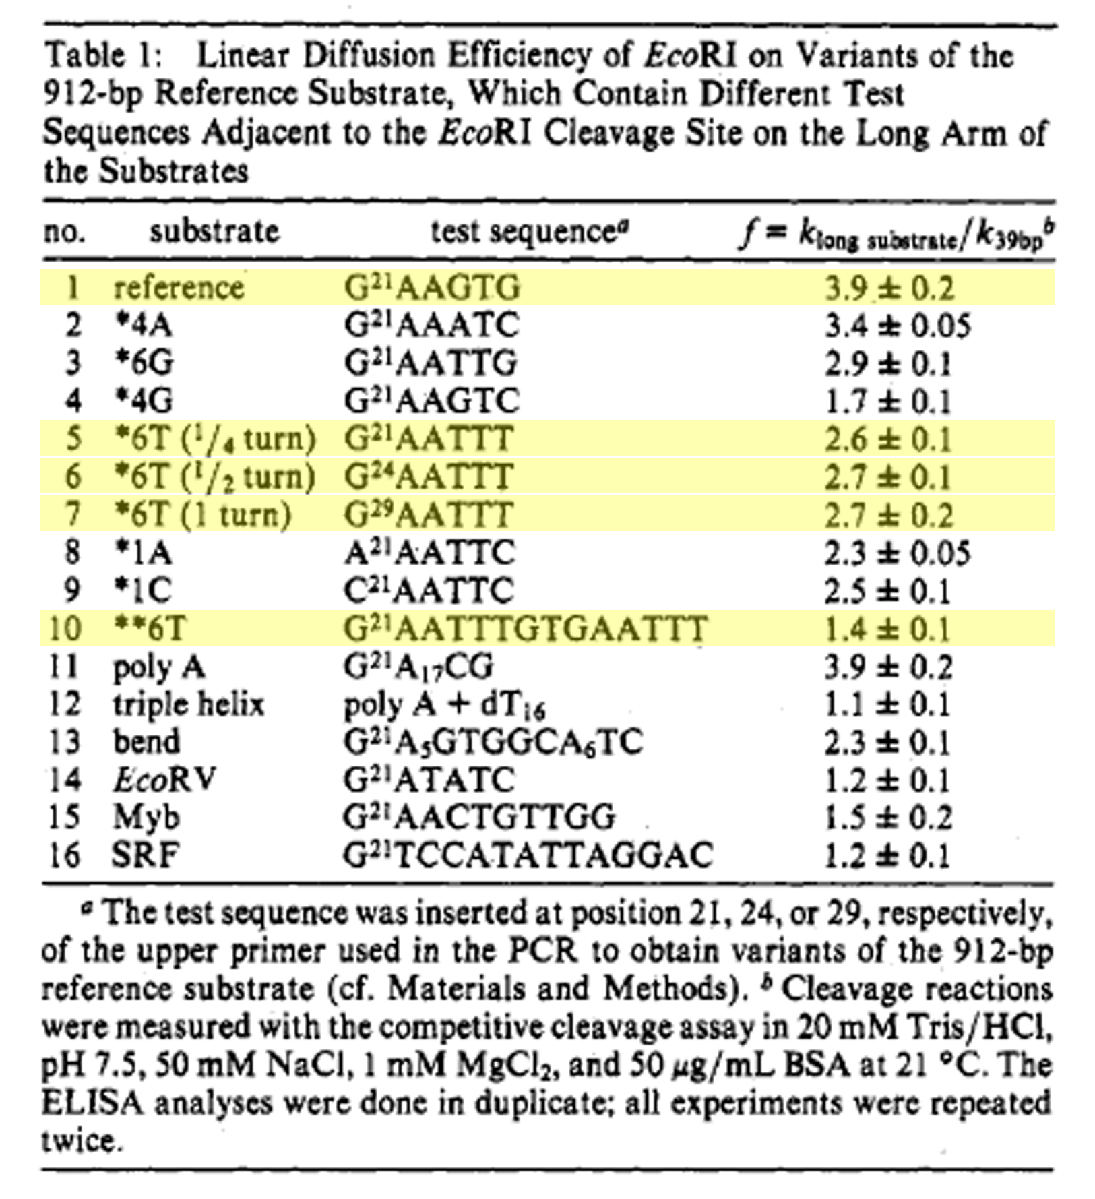

Slide 9


Slide 10
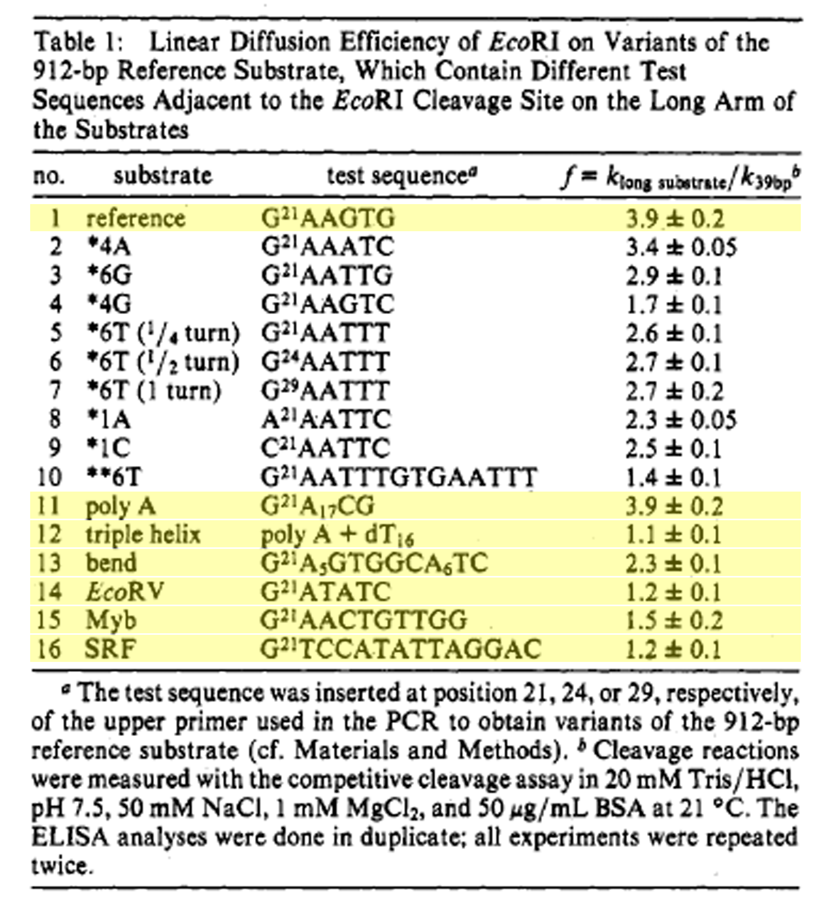
P_{t}
1.0
0.03
0.45
0.07
0.17
0.07

Slide 11


Slide 12
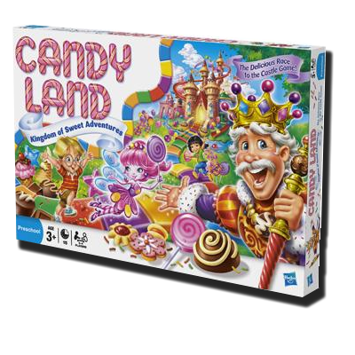
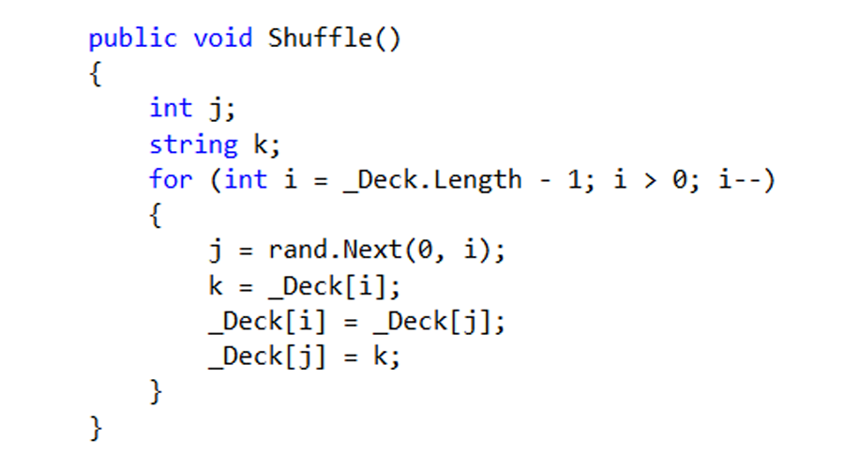
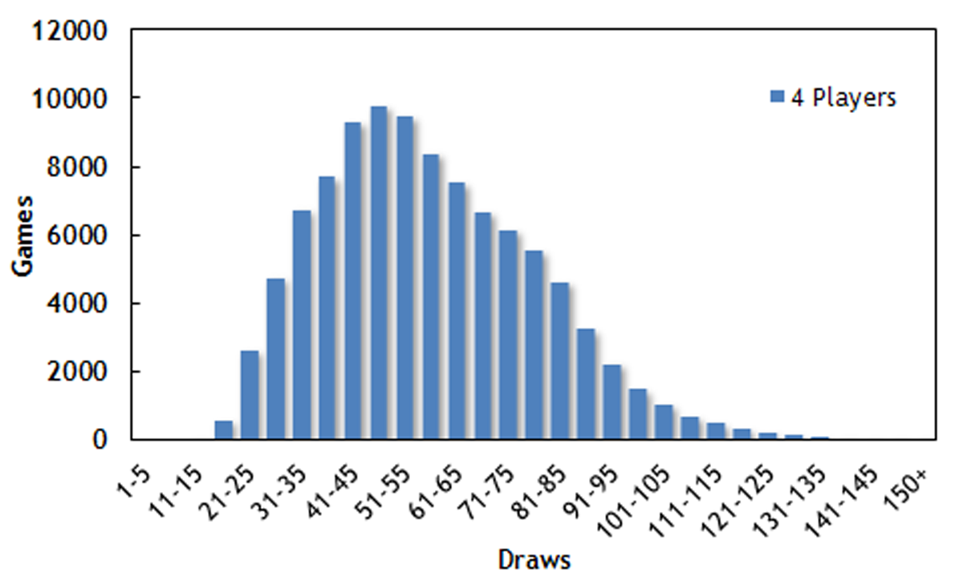
1,000,000 4 Player Games
Minimum Draws: 13
Maximum Draws: 204

Slide 13
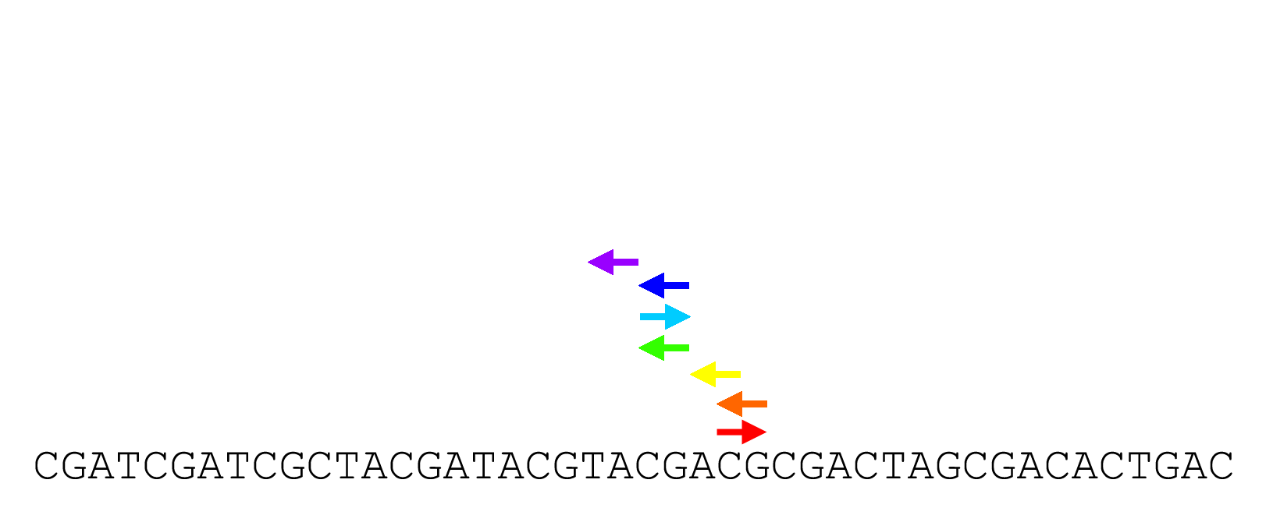
*

Slide 14

for star site @ 21

Slide 15
Pause (s)
2.2
5.2
19.3
7.5

Slide 16


Slide 17
